Slide 1

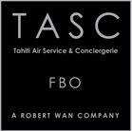






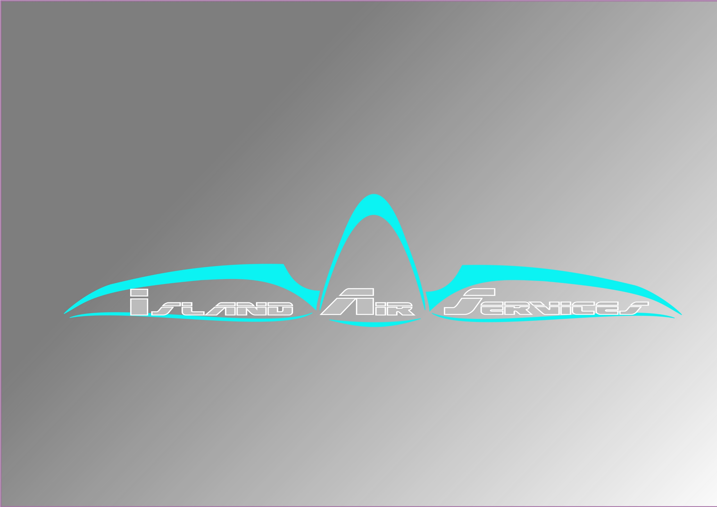







Slide 3





Slide 4




Slide 5

10/02/2026

Slide 6
Clients :
Direction de l’Aviation Civile
Air Loyauté
Vinci Airports
Etik Pf
Aéroport de Tahiti
HSF
IRONETIK
TPB – The Power of Blocks
TBSA
Service d’Etat de l’Aviation Civile PF
Islands Airline
TASC
Direction de l’Environnement
Islands Air Services
Air Tahiti Nui
Tahiti Nui Helicopters
Ministère des Transports
CNAM
Tahiti Air Charter
Tahiti Green Works
Partenaires :
PEN Aviation
TERCIEL
To70
Roland BERGER
CGX Aero
Dexios
Etik Pf
Milanamos
IRONETIK
TPB – The Power of Blocks

